Slide 1
Heartbeat classification from Phonocardiogram using deep learning
Manish Kumar Roy (20AE30031)
Ankit Kumar Prem (20AE30030)

Slide 2
Project introduction
Cardiovascular diseases (CVDs) are the leading cause of mortality worldwide, accounting for nearly 32% of all global deaths, as reported by the World Health Organization.
In recent years, deep learning has revolutionized medical diagnostics.
So, the primary objective of this project is to develop a sophisticated deep learning model that can accurately classify heart sounds from audio data acquired through stethoscopes.

Slide 3
Heart Chambers:
Heart Basics
Cardiac Cycle Overview:
Rhythmic process of the heart from one heartbeat to the next.
Two phases: diastole (relaxation and blood fill) and systole (contraction and pumping).
Healthy heart completes a cycle in 0.8 seconds.
Four chambers: two atria (left, right) and two ventricles (left, right).
Valve Functions:
Mitral and tricuspid valves open during ventricular diastole for filling.
Atrial systole forces final blood into ventricles.
Ventricular systole ejects blood to lungs and body organs.
Diastole and Systole:
Diastole is the heart's relaxation, allowing blood refill.
Atrial systole completes diastole, crucial for ventricular filling.
Ventricular systole powers pulmonary and systemic circulation, maintaining blood pressure.

Slide 4
Literature review
Historical Impact of Framingham Heart Study:
Researcher: Rachel Hajar, M.D.
Summary: Explored the transformative journey in understanding cardiovascular diseases (CVDs) through the Framingham Heart Study (FHS). The study identified and corrected misconceptions about CVD risk factors, leading to a paradigm shift in medical practices. Emphasizes the importance of tailored approaches based on FHS findings and current guidelines to reduce cardiovascular morbidity and mortality.
Machine Learning for Heart Sound Classification:
Researcher: Fatih Demir, Abdulkadir Şengür, Varun Bajaj, Kemal Polat
Summary: Proposed a method involving spectrogram generation, deep feature extraction using pre-trained CNN models (AlexNet, VGG16, VGG19), and classification using SVM. Evaluated on Classifying Heart Sounds Challenge datasets, showcasing superior performance over existing methods. Highlights the significance of early detection of heart diseases and the growing role of machine learning in automating and improving heart sound analysis.

Slide 5
Efficient Heartbeat Sound Classification with RNN:
Researcher: Ali Raza, Arif Mehmood, Saleem Ullah, Maqsood Ahmad, Gyu Sang Choi,and Byung
Summary: Integrated a Recurrent Neural Network (RNN) with innovative data framing and down-sampling techniques for heartbeat sound classification. Outperformed conventional methods with an accuracy of 80.8% for 12.5-s samples and 77.2% for 27.8-s samples on Dataset-B. Emphasizes the efficiency and generalizability of the proposed approach, suggesting the potential for automating heartbeat sound classification in diverse healthcare applications.
Classification of Heart Sounds Using Softmax Regression and Convolutional Neural Network
Researcher: J. Low and K. Choo
Summary: Applied deep-learning neural networks to classify heart sounds without the need for manual feature selection. Utilized Softmax Regression (SMR) and Convolutional Neural Network (CNN) for classification, outperforming SMR. Emphasizes ease of implementation and potential for real-time heart sound classification from mobile phones. The study, though not using mobile phones for signal capture, suggests significant implications for enhancing diagnostic accuracy and speed, particularly in remote or underserved areas.

Slide 6
Methodology
Data Collection
Data Preprocessing
Exploratory Data Analysis (EDA)
Feature Extraction
Data Preparation
Model Building
Model Training
Model Evaluation and Tuning
Prediction and Analysis

Slide 7
Data collection
Dataset compiled from global sources for the PASCAL - "Classifying Heart Sounds Challenge" to detect cardiac pathologies.
Dataset A: iStethoscope Pro app from the general public.
Dataset B: Clinical trials using DigiScope digital stethoscope.
Dataset A
Total Files: 176
Breakdown:
Normal: 31
Murmur: 34
Extra Heart Sound: 19
Artifact: 40
Unlabelled Test: 52
Dataset B
Total Files: 656
Breakdown:
Normal: 320
Murmur: 95
Extrasystole: 46
Unlabelled Test: 195

Slide 8
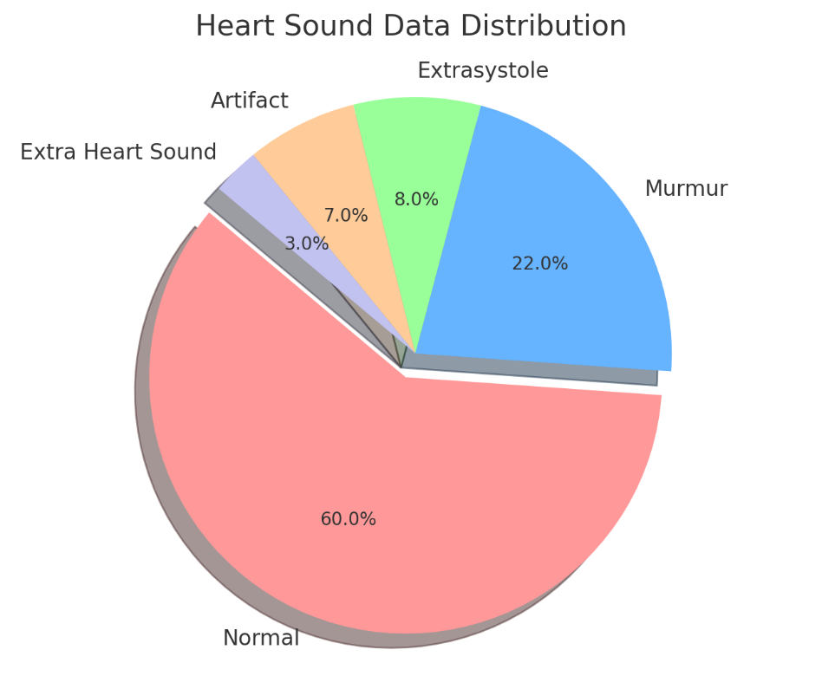
Data distribution

Slide 9
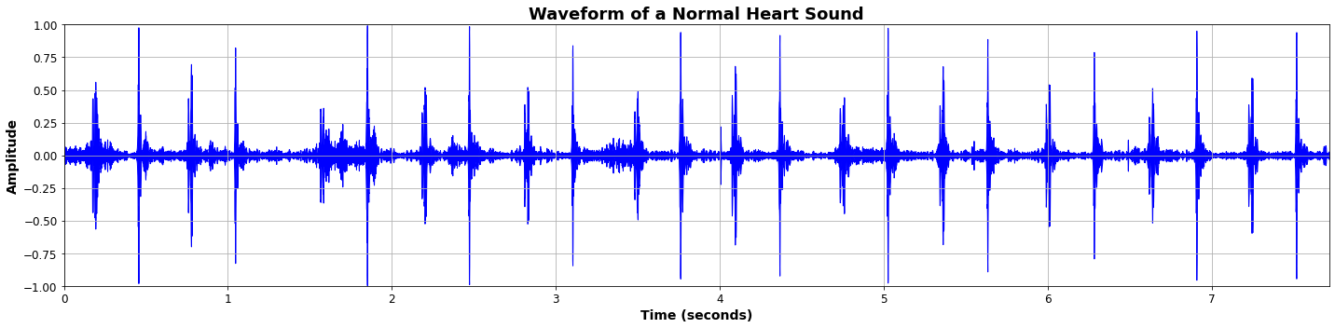
Data visualization
Waveform Visualization: A plot of the audio signal amplitude of air pressure over time.
Normal Heart Sound
Regular Heartbeat: Clear, repetitive peaks indicating a normal heart rhythm.
Heart Rate Calculation: Peak intervals used to calculate BPM.
S1 and S2 Presence: Large spikes for S1 ("lub") and smaller spikes for S2 ("dub") show typical heart sounds.

Slide 10
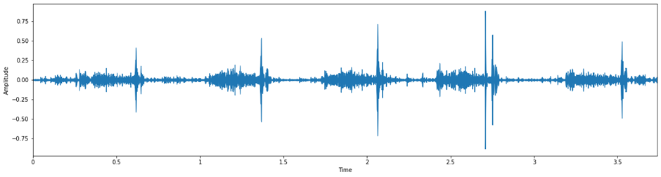
Murmur
Waveform Characteristics: Irregular peaks with varying heights and additional waveforms between primary heart sounds.
Heartbeat Consistency: Disrupted pattern with inconsistent spacing between peaks.
S1 and S2 Identification: Overlapping of spikes may occur, with additional sounds not present in normal heart sounds.
Abnormal Sounds: Additional peaks or a continuous, undulating waveform pattern indicating a murmur.

Slide 11
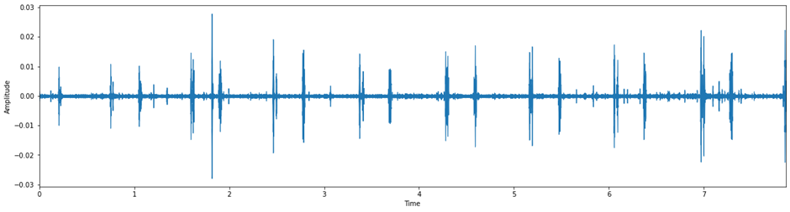
Artifact
Waveform Characteristics: Presence of erratic, non-rhythmic spikes unrelated to heartbeats.
Heartbeat Regularity: The basic heart rhythm may be obscured by the presence of artifact spikes.
S1 and S2 Identification: Difficulty in identifying S1 and S2 due to superimposed noise.
Rhythm Disturbances: The waveform shows disruptions that are inconsistent with normal heart sound patterns.

Slide 12

Data preprocessing

Slide 13
Category Encoding
Simplified heart sounds into three categories:
Artifact (0), Murmur (1), Normal (2).
Normal includes 'extrahls' and 'extrastole’.
Extrahls: Extra heart sounds that are generally considered normal variations, often found in healthy individuals.
Extrastole: Refers to extrasystole, which are extra or premature heartbeats. While they can sometimes indicate heart issues, they are also common in healthy hearts and not always a sign of underlying conditions.

Slide 14
14
Label Mapping
Created a label_to_int dictionary for converting text labels to integers.
Reverse mapping with int_to_label for decoding predictions.

Slide 15
15
Clip Standardization
Duration Limit: All audio files were standardized to have a maximum duration of 10 seconds.
Objective: Ensures consistency in the length of audio clips across the dataset.
Importance: Standardized clips facilitate uniform processing and analysis, making them suitable for model training and evaluation.

Slide 16
16
Feature Extraction with MFCC (Mel-Frequency Cepstral Coefficients)
Loaded audio files using the librosa library.
Calculated input length based on duration and sampling rate.
Ensured uniformity by padding shorter audio files.
Computed MFCCs to capture essential audio features.
Averaged MFCCs over time to create feature vectors.
Handled exceptions during loading and feature extraction.
Compiled extracted features into a data array.

Slide 17
17
Combining Datasets
Features extracted from both datasets A and B were combined to create a comprehensive dataset for analysis.

Slide 18
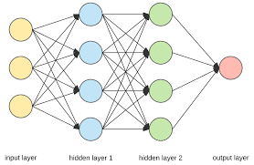
Modelling

Slide 19
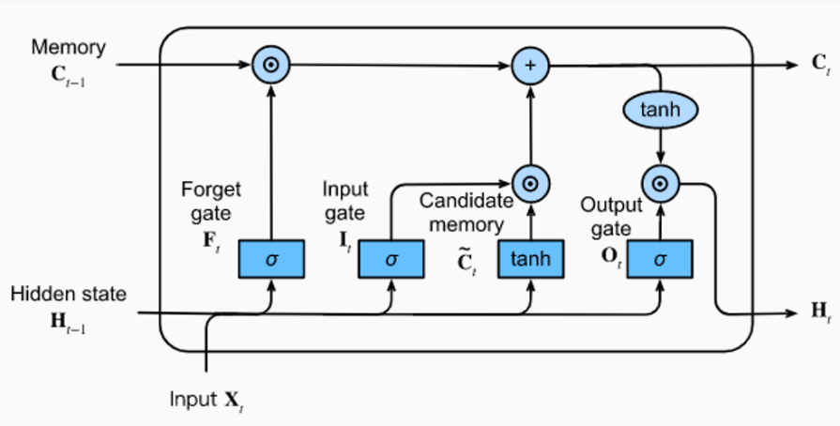
LSTM
(Long Short Term Memory)
Input Gate - It decides what new information is going to be stored in the cell state.
Forget Gate - This gate determines what information is going to be thrown away from the cell state.
Output Gate - After the cell state has been updated, the output gate controls what part of the cell state you're going to output

Slide 20
The Complete Architecture
Bidirectional LSTM input layer → BiLSTM → Dense → Dropout → Dense1 → Dense2
Dense2 → Dense3 → Flatten → Dense4
Layer Type | Output Shape | Number of Parameters
Bidirectional | (None, 25, 256) | 133,120
Dense | (None, 25, 128) | 32,896
Dropout | (None, 25, 128) | 0
Dense | (None, 25, 128) | 16,512
Dense | (None, 25, 64) | 8,256
Dense | (None, 25, 64) | 4,160
Flatten | (None, 1600) | 0
Dense (Output) | (None, 3) | 4,803
Total |  | 199,747
Trainable Parameters |  | 199,747
Non-trainable Parameters |  | 0

Slide 21
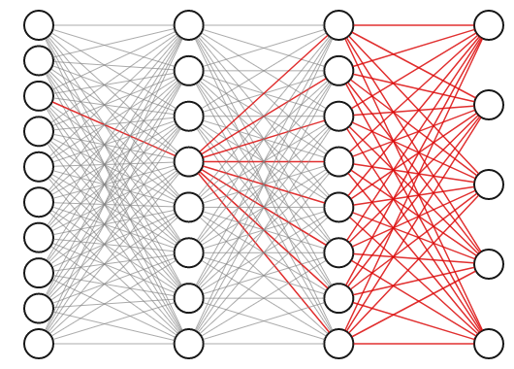
Training

Slide 22
22
Model Training key Hyperparameters
Loss Function: Categorical Crossentropy
Optimizer: Adam with a learning rate of 0.0001
Batch Size: 3
Epochs: 30

Slide 23
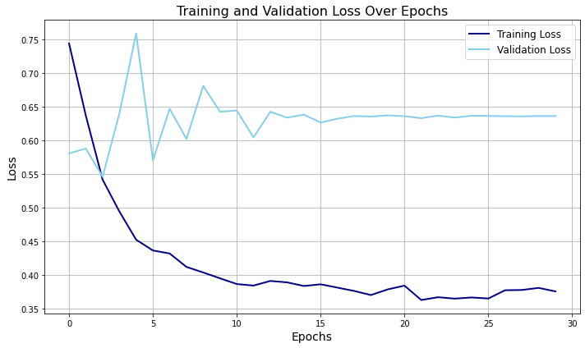

Slide 24
24
Training Progress
Initial Learning: Rapid improvement in training loss at the start of training.
Convergence: Training loss decreases and plateaus as epochs increase.
Validation Loss: Validation loss also decreases but plateaus at a slightly higher level than training loss.
Overfitting: No significant increase in validation loss, indicating no immediate overfitting.
Stability: Validation loss remains stable, reflecting consistent model performance.

Slide 25
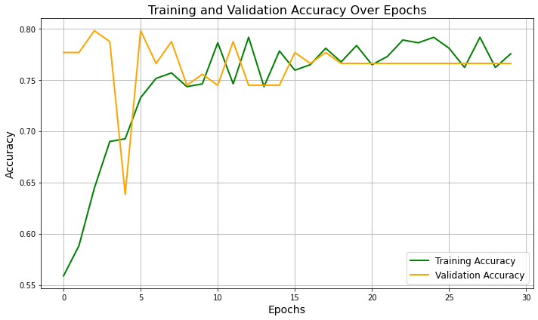
Accuracy vs. Epochs

Slide 26
26
Future Work
Attention Mechanisms: Incorporate attention layers to focus on relevant heart sound segments, improving the classification of subtle differences, especially for murmurs.
Transformer Architectures: Explore transformers for handling long-range dependencies in heart sound recordings, potentially boosting classification accuracy.
Ensemble Models: Combine CNNs and transformers in an ensemble to leverage their strengths for enhanced classification.
Vision Transformers (ViTs): Adapt ViTs for audio classification by converting audio signals into spectrogram images, revealing new patterns.

Slide 27
THANK YOU
Manish Kumar Roy
Ankit Kumar Prem

